Slide 1
LGE Security Specialist
Studio Project Phase 1
Team 5. 5verFlow
Notes:
Thank you for participating in the presentation.
This is Jinn, presenter of the day.
We are Team 5 called '5verFlow'.

Slide 2
History
The road we passed
Orientation
Feb `21
CMU e-learning
Apr `21
CMU Phase 1
Jun `21
Security Fundamental
vulnerability, SW engineering, secure coding
Introduction
Weekly Live Session
Team Building
e-Lecture & quiz
Studio Project
jetson nano, face recognition
SW Cha (Leader)
YK Choi (Requirement)
SJ Lee (Requirement)
DH Han (Infrastructure)
WL Kang (SW Dev.)
YJ Lee (System Design)
5verFlow
Weekly Live Session
Cyber Security
cryptography, Web, Network, Secure Coding
Security Testing
secure coding 2, exploitation, penetration, tools
Software Security
Security Engineering
threat modeling, secure design, fuzz testing, malware
Studio Project
Project evaluation
Coursera
Mar`21
KR live class
May `21
CMU Phase 2
Jun `21
Notes:
This is the roadmap and we had learned many security classes from February to now.
and Let me introduce my team and role
승욱 차 팀 리더
유경 최 리콰이어먼트
성준 리 리콰이어먼트
동혁 한 인프라스트럭쳐
우람 강 소프트웨어 디벨럽먼트
영진 리 시스템 디자인

Slide 3

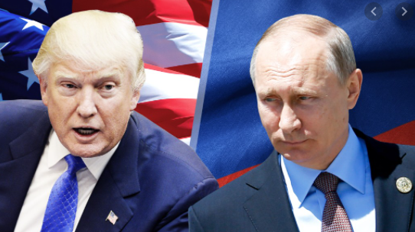

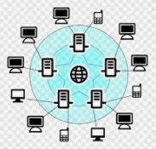
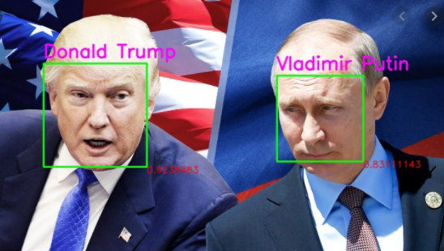
Secure Face ID
The stuff we made
The original program is a face recognition system for video camera and video file.
but it did not consider security, so we tried to make it secure with learnt knowledge.
Make it secure !!!
Notes:
here is our goal of studio project phase 1.
the name is ‘Secure Face ID', it's a face recognition system for video camera and video file.
we applied several cyber security techniques into this, based on last studying. so I'll show you what/how were we applied.

Slide 4
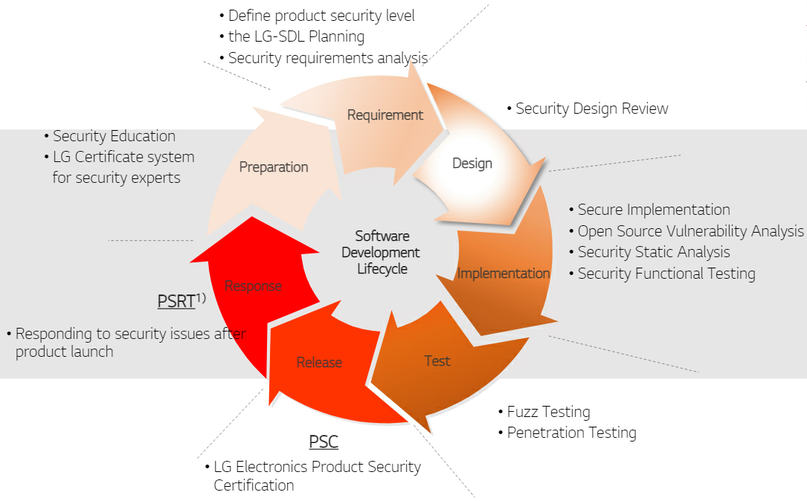
Security Development Life-cycle
The way we did
Our activity :
User Requirement
Project Requirement
Software Requirement
Security Requirement
Our activity :
Software Architect Design
Quality Attribute
Security Design Review
Our activity :
(Education)
Cousera
MOOC
CMU e-lecture
CMU Live Zoom
Our activity :
Secure Coding
Static Analysis
LG SDL
Phase 2
Notes:
First of all, we followed the LG Security Development Life-cycle during the development process.
it is an incremental spiral model and we had processed preparation, requirement analysis, design, implementation in phase 1.
As a result of following this process, we found that it was consistent with what we learned during this course.
Therefore, the presentation also follows the sequence of this SDL cycle.
and remaining testing, release and responding to security will be processed in phase 2.
PSRT - Product Security Response Team
PSC - It finally certifies that LG-SDL security activities have been performed on the product.

Slide 5

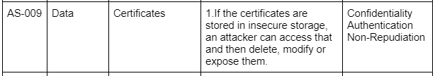
Asset Identification
Requirement
Requirement Analysis
STRIDE
OWASP
Six-part Quality Attribute Scenarios
Asset Identification
Threat (Vulnerability) Analysis
Security Risk Assessment
Mitigating Threats
1. User RQ
2. Project RQ
3. SW RQ
4. SW, HW
1. Asset list
2. DFD
1. Threat
1. Security
Risk Level
1. Security Req.
Asset identification was possible based on functions derived through system definition, scenario creation, and requirement analysis.
Assets to protect from threats
Jetson Nano : server application
User display & System control application
Data (video frame, meta data, picture, certificate..)
Network interface
HW : Camera
...
<Asset List>
Asset List : https://docs.google.com/document/d/17hBksXkO3t7uZDN-yFIo5x02YWFBjmVHrCzRcF1x-1A
Notes:
we followed this sequence to write security requirement.
At first, we analyzed requirements for functionality and derived asset list and DFD.
for example: List and analyze the certificate asset as AS-009 like this.

Slide 6
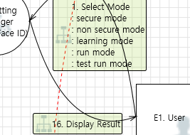
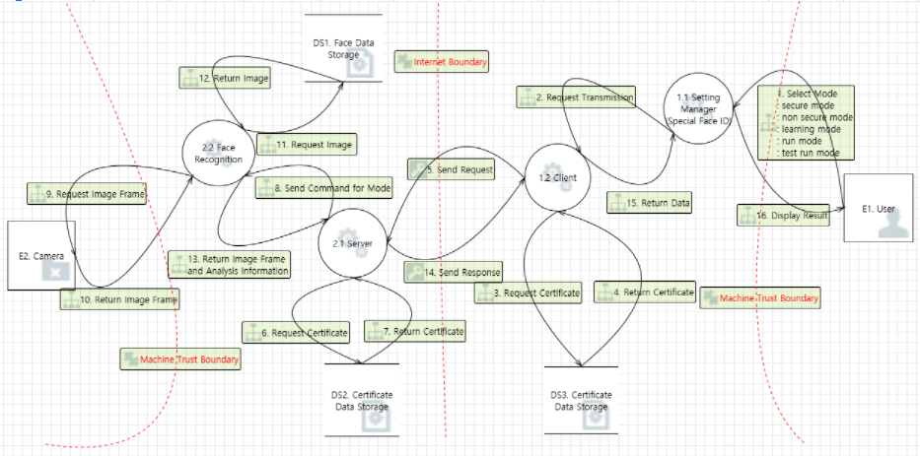
Threat Analysis
Requirement
STRIDE
OWASP
Six-part Quality Attribute Scenarios
Asset Identification
Threat (Vulnerability) Analysis
Security Risk Assessment
Mitigating Threats
1. User RQ
2. Project RQ
3. SW RQ
4. SW, HW
1. Asset list
2. DFD
1. Threat
1. Security
Risk Level
1. Security Req.
We mainly focused on boundary area of DFD and extracted following risk items especially data exchanges between entities.
HMI; Invalid data could cause buffer overflow or connecting to unauthorized system
Network Communication; data sniffing
Data Consistency; user data corruption
<DFD>
Security Requirement Analysis working sheet : https://docs.google.com/spreadsheets/d/1Mx0e_mOhwO24hP5NUkUQ4YFxJ2HmPbjVOljCh0Gsd7E
Notes:
At Second, we made threat model from DFD with MS threat modeling tool.
But there had been too many threats so we focused on boundary area of DFD.
especially data exchanges between each entities were recognized as key threats.

Slide 7
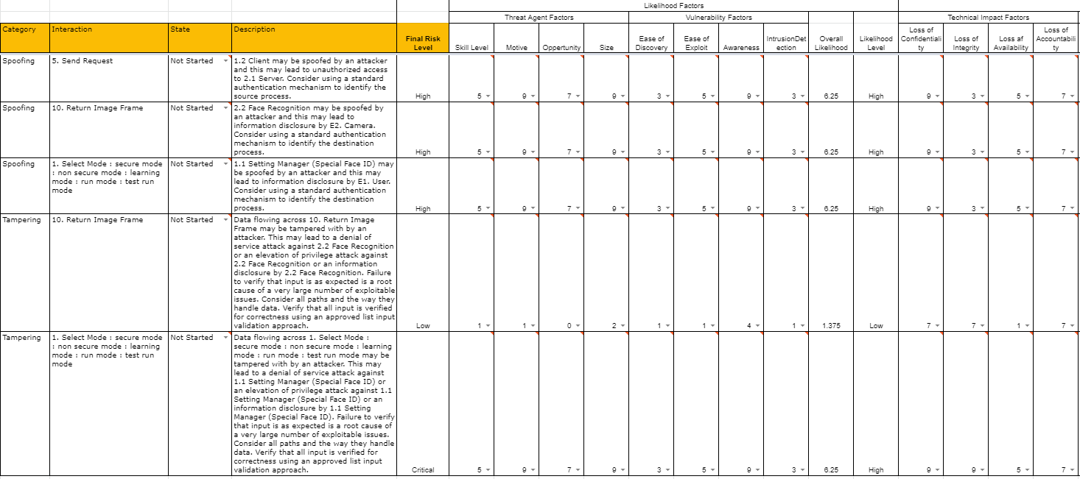
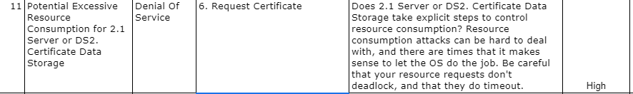
Risk Assessment
Requirement
STRIDE
OWASP
Six-part Quality Attribute Scenarios
Asset Identification
Threat (Vulnerability) Analysis
Security Risk Assessment
Mitigating Threats
1. User RQ
2. Project RQ
3. SW RQ
4. SW, HW
1. Asset list
2. DFD
1. Threat
1. Security
Risk Level
1. Security Req.
19 threats / 5 category
Input Validation
Secure Data Transmission
Authentication
Secure Data Store
Logging
<Security Risk Level>
Security Requirement Analysis working sheet : https://docs.google.com/spreadsheets/d/1Mx0e_mOhwO24hP5NUkUQ4YFxJ2HmPbjVOljCh0Gsd7E
Notes:
at third, We selected 19 threats from the modeling result and we categorized them as following 5 categories to define risk.
the category is "Input Validation, Secure Data Transmission, Authentication, Secure Data Store, Logging"
then we assessed selected risks with OWASP methodology.

Slide 8
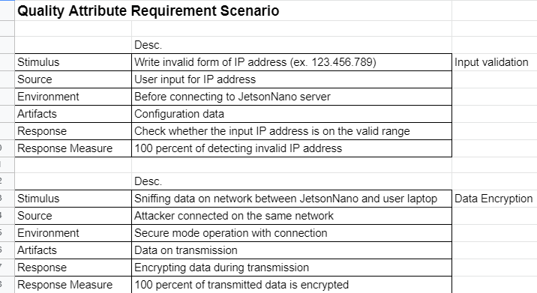
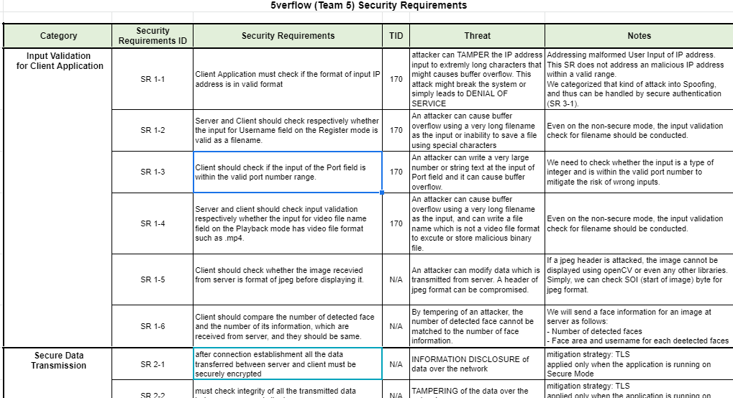
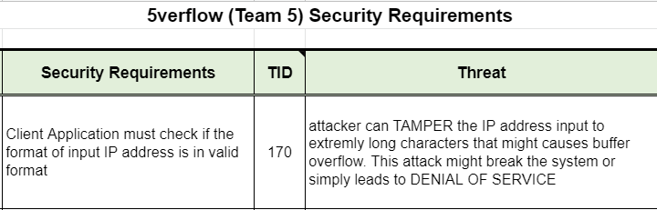
Mitigating Threats
Requirement
STRIDE
OWASP
Six-part Quality Attribute Scenarios
Asset Identification
Threat (Vulnerability) Analysis
Security Risk Assessment
Mitigating Threats
1. User RQ
2. Project RQ
3. SW RQ
4. SW, HW
1. Asset list
2. DFD
1. Threat
1. Security
Risk Level
1. Security Req.
<Quality Attributes>
<Security Requirement>
Security Requirement Analysis working sheet : https://docs.google.com/spreadsheets/d/1Mx0e_mOhwO24hP5NUkUQ4YFxJ2HmPbjVOljCh0Gsd7E
Notes:
at last, after we assessed risk, we discussed about mitigating risk and related quality attributes,
finally we made security requirement.
(마우스 클릭 後)
For example, we made our security requirement to check user input,
to address tampering and Denial of Service
that input is validated

Slide 9
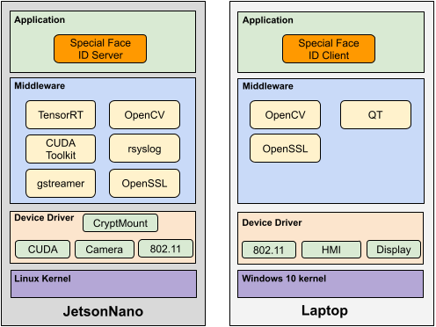
Security Design
Design
Write invalid form of IP address (ex. 123.456.789)
Input Validation : Input Data Verifier
Sniffing data on network between JetsonNano and user laptop
Data Encryption : OpenSSL v1.1
Connection from unknown client
Authentication : Key from trusted certificate authority (JetsonNano)
Secure Storage
cryptmount
Logging
rsyslog
Software Architect Design Document : https://docs.google.com/document/d/1NJaph-tavyyWxa13gYBciuc1nuE-puGsy08pcuRcfRk
Notes:
This is a software overview diagram.
Three main items for our security design are emphasized by colored border lines
first, input validation for invalid form of IP address
second, Data Encryption using OpenSSL
Authenticating with trusted authorized certi.
third, Secure storage to store valuable assets, key and image.
Secure storage is implemented using cryptomount
in addition, connection logging with rsyslog which supports TLS is included.nvalid

Slide 10
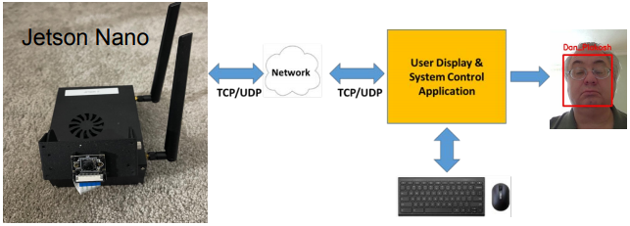
Input Validation
Design
Threat 1 Attacker tries to tamper the data transmitted from Jetson Nano to client program
e.g. invalid image header of JPEG format
Vulnerability 1 Data transmitted from Jeson Nano can be tampered.
Mitigation 1 Check the image format of received data is valid to JPEG.
How to
JPEG header check by parsing SOI (Start of Image) and EOI (End Of Image) bytes which have fixed values.
How to
Checking the input validity while in typing on the edit box of client program and deny input when violate rules
Attack!
Mitigation 2 Application checks if input is valid or not and use functions that restrict the number of bytes
Threat 2 Attacker tries to force the stack overflow using invalid input and inject the executable code. e.g. user name, ip address
Vulnerability 2 Application is implemented with C/C++, which has string functions that are vulnerable to overflow, and do not check input size and format.
Attack!
Notes:
Let's go into more detail about our design approach to mitigate risk.
there are several input items need to consider verification. IP address, User name and Image data as well.
in this threat 1 case, we can assume that attacker can tamper the data transmitted from server to client.
for example, tampering invalid image header of JPEG format.
client cannot decode the image and show it correctly, if the header is broken.
in this situation, user cannot confirm who is in there.
so we decided to check the image format of received data at client side.
basic logic is investigating SOI and EOI of received data are correctly.
Threat 2 case is prevent malicious user input at GUI side by denying input when input data violets input format rules.

Slide 11
Secure Data Transmission
Design
Threat 1 Attacker connects on the same network and tries sniffing data between Jetson Nano and User Application. Attacker wants to get secure information, e.g. password, or change the data e.g. face data.
Vulnerability 1 Currently, connection is not secure and data is not encrypted.
Attack!
Threat 2 Jetson Nano(server) or User Application(client) might be spoofed by an attacker (SPOOFING) for an unauthorized access.
Vulnerability 2 Neither authenticate each other.
Mitigation 1 Data encryption in transit. TLS is applied for encryption. Ciphersuite : TLS_AES_128_GCM_SHA256
Mitigation 2 Server and Client must mutually authenticate each other. Therefore mutual authentication of TLS is applied.
TLS connection
Applied Technology :
Go to the next
Notes:
in other design, we considered secure data transmission.
as we already know, communication over the internet is one of the most vulnerability.
normal communication methods cannot secure both data and connections.
They are always exposed to information disclosure and spoofing threats.
so we applied TLS(transport layer security) technique to secure it.

Slide 12

TLS Implementation
Design
X.509 Certificate
Long key length: 4096 bits, AES-256 encrypted
Stored in secure storage (encrypted, not accessible to unauthorized user)
Permission to the keys are restricted so that only the owner can read and no one is able to write and execute
Certificate status (valid or revoked) are managed
TLS
TLS v1.3: faster handshake and stronger security by removing static key exchanges
Cipher Suite: TLS_AES_256_GCM_SHA384
AES 256: according to NIST Recommendations
GCM: provides both confidentiality and authentication using AAD
SHA384: susceptible to length extension attack
Notes:
This slide provides details on TLS implementation.
Considering the performance and security trade-off, we chose the length of the key to forty-ninety six bits,
longer than the usual size - which is twenty-forty eight, and encrypted it using AES.
Key and Certificates are stored in secure storage, in which files are encrypted and access-restricted to unauthorized users.
The permission of certificates are Read-Only to the owner.
In addition, certificate revocation list is managed to prevent unauthorized user access using expired or revoked certificate.
you can see the valid certificate is marked V and revoked certificate is marked R
Next I will give you a brief introduction of protocol and cipher suite we‘ve chosen.
TLS version dot three is chosen for improved security and performance.
About Cipher Suite, AES-GCM is chosen for strong encryption and authentication.
Using Additional Authentication Data, integrity and authentication are checked.
We choose three eighty four bits long hashes considering security - performance trade off.

Slide 13
Data Validation during transfer
Design
From Server to Client - Data Overview
Send a image data combined with face region information
Time synchronization between image and face region info
Robust than sending simple structured data only
Total data size
int
int
vec<FaceRegion>
vec<uchar>
Total data size
Image data size
Face Region information
Image data (JPEG format)
Registered : This field prevent ambiguity of various unknown people while registering a new person.
FaceRegion
Face 1
Face 2
...
Face N
int x4
bool
char[MAX_LEN]
Rect
(Left, Right, Top,Bottom)
Registered
UserName
Notes:
Now, you can see the data packets before encrypted when the server sends to client.
We send a imagedata with appending vectorized face region information.
Compared to sending image and face data separately, we can show image and related face information more simultaneously.
Also, in terms of security, we thought that combining two different type of data is more robust from the attackers than simple structured data only like FaceRegion.
the structure of FaceRegion is composed of three parts, four point of face boundary, username, and a registered bit which indicates whether this face is registered user or not.
The number of unrecognized faces can be counted using this field and it can prevents ambiguity while registering a new person. If there are several unknown people, the client can deny registration request.

Slide 14
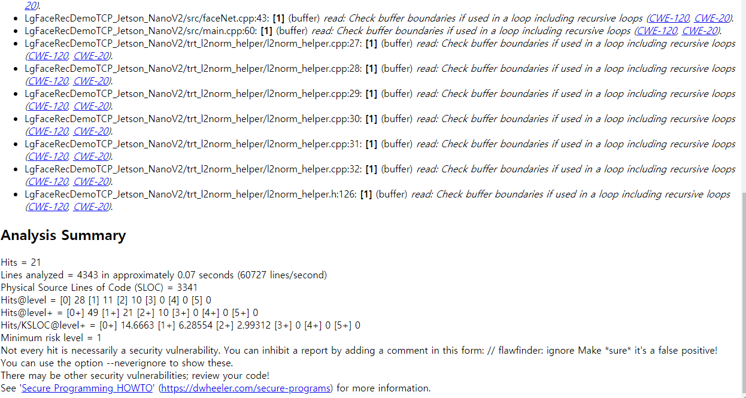
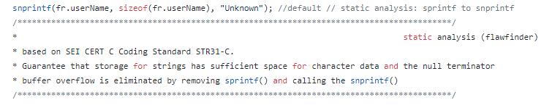
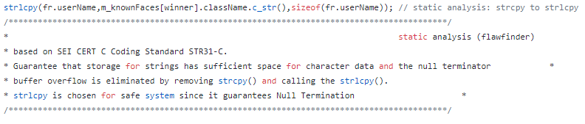
Secure Coding
Implementation
Static Analysis
FlawFinder : total 21 hits
fixed !!
Notes:
during implementation after the design phase, we performed static analysis and fix by using flawfinder before commit into git.
for example, every sprintf were replaced with snprintf and strcpy were replaced with strlcpy.

Slide 15
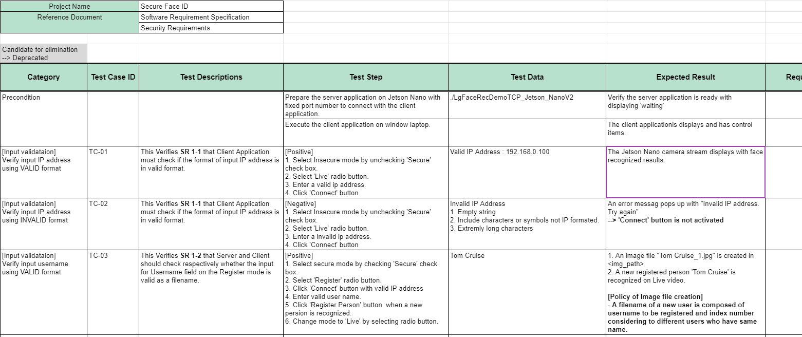
Verification - Test cases
Implementation
20 test cases for 5 categories
https://docs.google.com/spreadsheets/d/1v_cauZ085o0E29nCD0ZCVTvivRbOVXEpa1OFGBs_ujs
Notes:
congratulation, we are almost at the end.
actually test cases are investigated during design phase but explain it lastly.
we derived 20 test cases related with selected 5 categories like following.
but we need more investigation about test automation.

Slide 16
Studio Project Phase 1
Secure Face ID
Demonstration
& Thank You

